Slide 1
XenonVita
"Transforming Healthcare with Technology"

Slide 2



Team Members
S.m.Refat
Monowar Hossen Sourav
Mohammad Masum Jia
Frontend
Backend & DevOps
Frontend

Slide 3

About Us
Who We Are:
We are a team dedicated to revolutionizing healthcare by integrating innovative technology, improving accessibility, and fostering a supportive community for better health outcomes.
Why This Project?
We need this project to improve healthcare accessibility, streamline services, enhance communication, and empower communities for better health outcomes.

Slide 4


What We Believe
Vision
Mission
"To revolutionize healthcare by seamlessly integrating technology to provide accessible, efficient, and personalized medical services, fostering a healthier and more connected community."
"To become a global leader in digital healthcare solutions, empowering individuals and healthcare providers through innovative technology, ensuring equitable access to quality medical services, and creating a thriving ecosystem for wellness and collaboration."

Slide 5
Features
Online & Offline Appointment Scheduling.
Prescription Submission & Home Delivery.
Location-based Disease Alerts.
Blood Donation System.
Doctor & User Communities.
Blogging by Doctors.

Slide 6




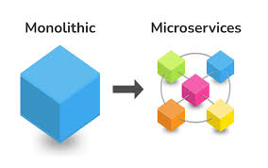

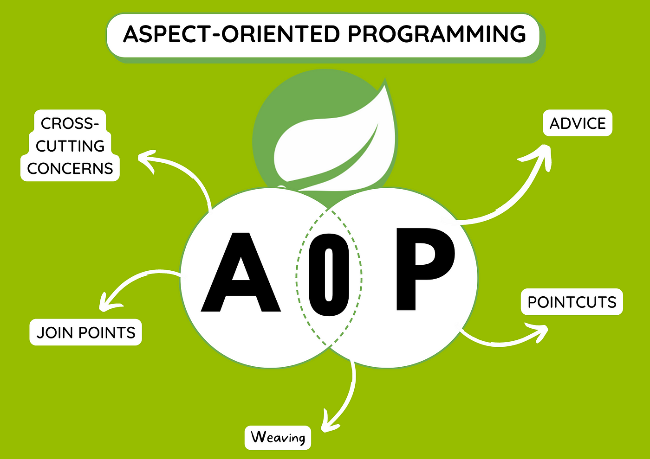
Backend Tech Stack
Core Technologies :
Spring Boot: Rapid development and robust backend framework.
Microservices: Scalability and modularity.
Redis Cache: Enhanced performance with caching.
PostgreSQL: Reliable and robust database solutions.
JWT: Secure Authentication and Authorization.
AOP: for Authorization and Logging
Kafka: Asynchronous communication using message brokers.
SMTP Setup: Email notifications.

Slide 7

Frontend Tech Stack
React
Component-based architecture.
State management (e.g., Redux or Context API).
Responsive and interactive UI design.

Slide 8



DevOps Overview
Kubernetes: Orchestrates containers for scalability and availability.
Jenkins: CI/CD pipelines for automated builds and deployments.
Docker: Containerization ensures consistency across environments.

Slide 9
Key Features
High-Level Architecture
User Authentication & Authorization (JWT).
Caching with Redis for improved performance.
Asynchronous messaging with Kafka.
SMTP for email services (e.g., order confirmation, password reset).
Backend services (Spring Boot)
Frontend (React)
Database
Cache (Redis)
Message Broker (Kafka)
DevOps components (Kubernetes, Jenkins, Docker)

Slide 10
Innovation
Benefits
Disease alert system using geolocation.
Community-driven healthcare (doctor and user).
Home delivery of prescribed medicines.
Enhanced accessibility to healthcare.
Reduced time for medical services.
Increased engagement between users and doctors.

Slide 11
Future scope
AI-based symptom checker.
Support for multiple languages.
Integration with wearable health devices.

Slide 12

Source Code Management
GitHub:
Version control and collaboration.
Centralized repository for all codebases (frontend, backend, and DevOps scripts).
Enables seamless teamwork with pull requests, code reviews, and issue tracking.
CI/CD integration with Jenkins for automated builds and deployments.

Slide 13
Thank You

